Slide 1

Big Data Farm Insurance
Nanette Mickelsen
Stephanie Chen
Priyanka Kulkarni
CK Huang
Notes:
Intro of team: Priyanka is our Technical Solution Architect, Stephanie and Ck are the Data Analysts of the team, and I’m Nanette, the Business Analyst

Slide 2

Business View
Case Study Problems Highlights
Key Trends
Notes:
Intro: Generally, Farm Insurance can be costly and it’s resulting impacts are felt on a widespread basis as the world population has been growing along with the demand for profitable farm production, which is a key global concern.
Traditional methods: The methods that insurers have been using can be ineffective since they are based on historical data, which can be limited and biased due to reliance on past catastrophic climate events. Also, there is limited accurate predictive capability with this approach since the data is historical. Additionally, the different data collection and analysis methods and system processing that is used by the separate functions within the insurers operations can lead to inefficiencies and gaps.
Results: All this can result in conservative pricing on the part of the insurer and a limited product offering mix that is not appealing to the customer base. Decisions may be outdated and highly inaccurate due to lack of real time monitoring and predictive capabilities. In summary, the industry will not be able to adequately meet the global need of affordability
Competitive pricing and appropriate product offerings are dependent on 1) cost effective and accurate data gathering and analysis, 2) accurate risk assessments and predictive capabilities, 3) fraud detection capabilities, and 4) timely gathering and interpretation of customer sentiments.

Slide 3
Farm Insurance Current State
Traditional methods used by Insurers
Largely reliant on historical weather & limited yield data
Limited predictive capabilities
Disparate data collection and processing
Analysis is inefficient
Resulting impacts
Conservative pricing and limited offerings
Decisions based on outdated/non-predictive data
Industry does not meet global need of affordability
Notes:
Intro: Generally, Farm Insurance can be costly and it’s resulting impacts are felt on a widespread basis as the world population has been growing along with the demand for profitable farm production, which is a key global concern.
Traditional methods: The methods that insurers have been using can be ineffective since they are based on historical data, which can be limited and biased due to reliance on past catastrophic climate events. Also, there is limited accurate predictive capability with this approach since the data is historical. Additionally, the different data collection and analysis methods and system processing that is used by the separate functions within the insurers operations can lead to inefficiencies and gaps.
Results: All this can result in conservative pricing on the part of the insurer and a limited product offering mix that is not appealing to the customer base. Decisions may be outdated and highly inaccurate due to lack of real time monitoring and predictive capabilities. In summary, the industry will not be able to adequately meet the global need of affordability
Competitive pricing and appropriate product offerings are dependent on 1) cost effective and accurate data gathering and analysis, 2) accurate risk assessments and predictive capabilities, 3) fraud detection capabilities, and 4) timely gathering and interpretation of customer sentiments.

Slide 4
Key Trends
Use of Big Data in Agriculture is rapidly increasing
Farm Insurance can leverage innovations
Key sources of data relevant to Farm Insurance
Yield Data
Weather Data
Sensing Data
Customer Sentiment Data, Social Media
New approaches use a combination of data
Analysis of unstructured as well as structured data
Notes:
In contrast with the traditional use of disparate applications, processes, and reports, Farm Insurance in today’s world can benefit from more precise and holistic approaches.
First and foremost, the ability to provide effective Farm Insurance offerings requires a sufficient supply of high quality relevant data that is timely and reliable and can be both structured and unstructured.
The use of Big Data in most industries today is maturing due to continuous innovations and increasing sophistication. The Agriculture industry, is in turn rapidly catching up, given that there are still some practices and business rules to be worked out. Big Data does exist within the industry and will likely to continue to increase.
What do we mean by Big Data in reference to it’s usefulness to Farm Insurance? The Key sources being looked at by many in this industry segment are 1) yield data (based on historical and current measurements of crop yields), 2) weather data (weather pattern data gathered from geographically dispersed weather stations), 3) sensing data (data gathered from satellites providing topography info), and 4) customer sentiments (customer feedback and sentiments regarding the industry and products that ware gathered from websites, social media such as Facebook and Twitter, customer surveys/questionnaires, and customer call center records).

Slide 5
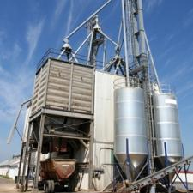
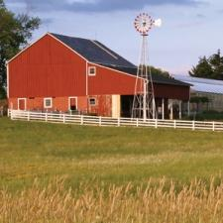

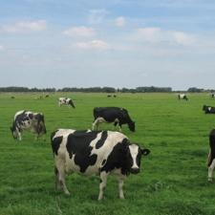
Notes:
The truly revolutionary aspect of Big Data analytics is that it provides the ability to analyze both structured and unstructured data. This is key for industries that need to consider the additional flexibility and responsiveness to their customer’s needs and concerns in designing their product offerings. Real time access to customer sentiments can greatly accelerate the tailoring of products to fit changing needs and ensure the industry remains relevant to their clients.

Slide 6
High Level Architecture
Proposed Solution
Proposed Solution Architecture
Notes:
Intro: Generally, Farm Insurance can be costly and it’s resulting impacts are felt on a widespread basis as the world population has been growing along with the demand for profitable farm production, which is a key global concern.
Traditional methods: The methods that insurers have been using can be ineffective since they are based on historical data, which can be limited and biased due to reliance on past catastrophic climate events. Also, there is limited accurate predictive capability with this approach since the data is historical. Additionally, the different data collection and analysis methods and system processing that is used by the separate functions within the insurers operations can lead to inefficiencies and gaps.
Results: All this can result in conservative pricing on the part of the insurer and a limited product offering mix that is not appealing to the customer base. Decisions may be outdated and highly inaccurate due to lack of real time monitoring and predictive capabilities. In summary, the industry will not be able to adequately meet the global need of affordability
Competitive pricing and appropriate product offerings are dependent on 1) cost effective and accurate data gathering and analysis, 2) accurate risk assessments and predictive capabilities, 3) fraud detection capabilities, and 4) timely gathering and interpretation of customer sentiments.

Slide 7
Proposed Solution
Utilize a combination of Structured Data, Semi-Structured Data, and Unstructured Data
Data sources fitting structured analysis approach
Yield and Weather data
Data sources that are semi-structured
WebLogs
CDR
Sensor
Customer Sentiment
Data sources that are unstructured
Satellite info
Social Media
Notes:
Intro: Generally, Farm Insurance can be costly and it’s resulting impacts are felt on a widespread basis as the world population has been growing along with the demand for profitable farm production, which is a key global concern.
Traditional methods: The methods that insurers have been using can be ineffective since they are based on historical data, which can be limited and biased due to reliance on past catastrophic climate events. Also, there is limited accurate predictive capability with this approach since the data is historical. Additionally, the different data collection and analysis methods and system processing that is used by the separate functions within the insurers operations can lead to inefficiencies and gaps.
Results: All this can result in conservative pricing on the part of the insurer and a limited product offering mix that is not appealing to the customer base. Decisions may be outdated and highly inaccurate due to lack of real time monitoring and predictive capabilities. In summary, the industry will not be able to adequately meet the global need of affordability
Competitive pricing and appropriate product offerings are dependent on 1) cost effective and accurate data gathering and analysis, 2) accurate risk assessments and predictive capabilities, 3) fraud detection capabilities, and 4) timely gathering and interpretation of customer sentiments.

Slide 8
Proposed Solution Architecture
Source Data
Structured
Yield Sample - Yield Data

Slide 9
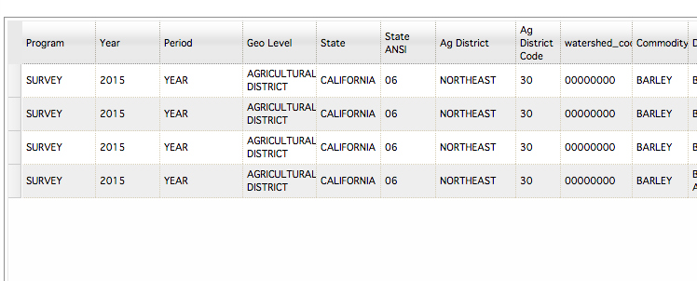
Sample - Yield Data

Slide 10
Proposed Solution Architecture
Source Data
Structured
Yield
Weather Data

Slide 11
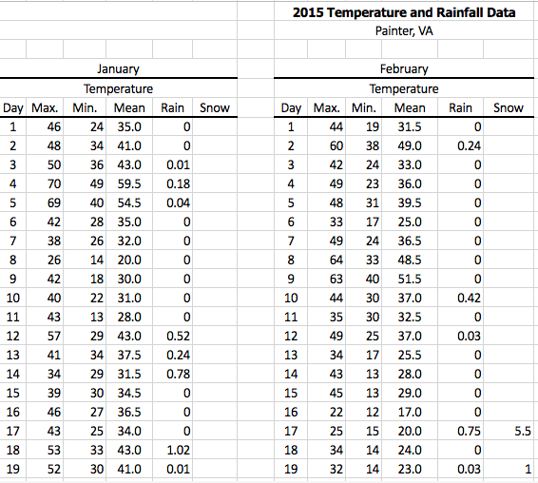
Sample - Weather Data

Slide 12
Proposed Solution Architecture
Source Data
Structured
Yield Data
Weather Data
Semi Structured
CDR - Logs

Slide 13

CDR

Slide 14
Proposed Solution Architecture
Source Data
Structured
Yield Data
Weather Data
Semi Structured
CDR - Call Center Logs
Web Logs Data

Slide 15
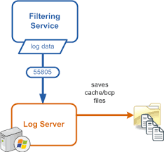
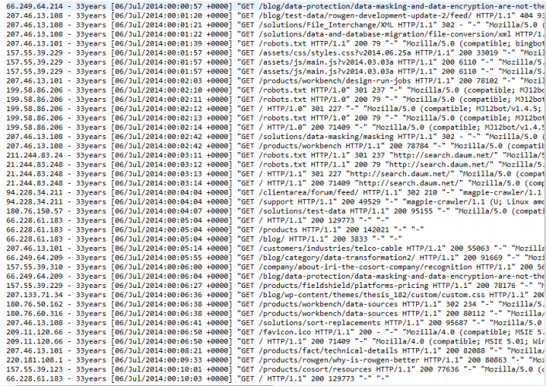
Web Log Data

Slide 16
Proposed Solution Architecture
Source Data
Structured
Yield Data
Weather Data
Semi Structured
CDR - Call Center Logs
Web Logs Data
Unstructured
Satellite Data

Slide 17
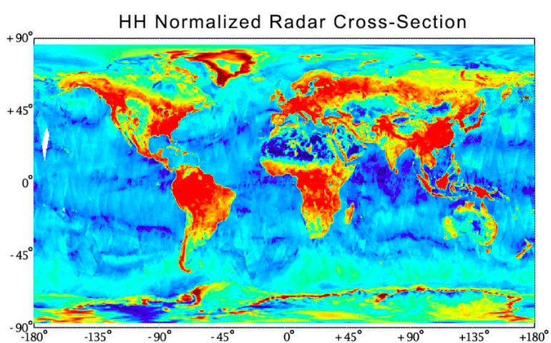
Satellite Data

Slide 18
Proposed Solution Architecture
Source Data
Structured
Yield Data
Weather Data
Semi Structured
CDR - Call Center Logs
Web Logs Data
Unstructured
Satellite Data
Social Media Data

Slide 19
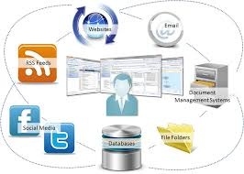
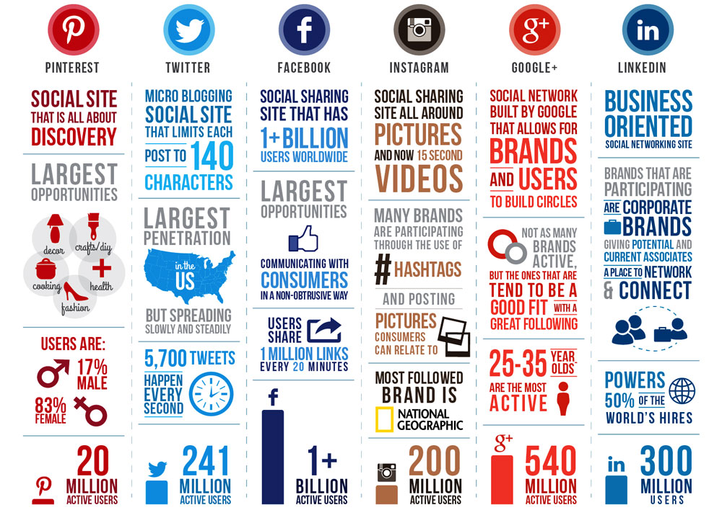
Social Media Data

Slide 20
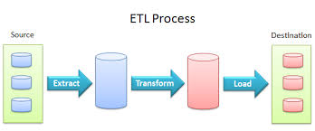






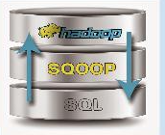
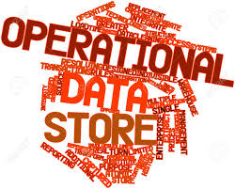
Proposed Solution Architecture
Source Data
Structured
Yield Data
Weather Data
Semi Structured
CDR - Call Center Logs
Sensor Data
Web Logs Data
Unstructured
Satellite Data
Social Media Data
Data Acquisition
Data Organization
Analysis
Actionable BI
Reporting and Dashboard
Advanced Analytics
Alerting, Notification
Interactive Discovery
Data

Slide 21
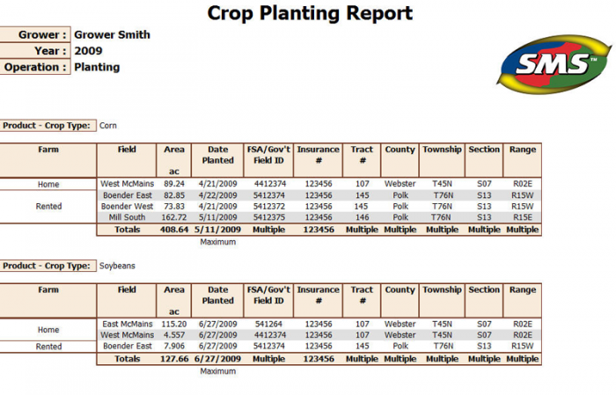


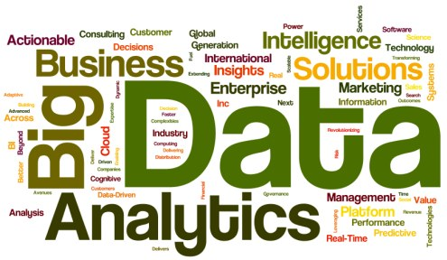
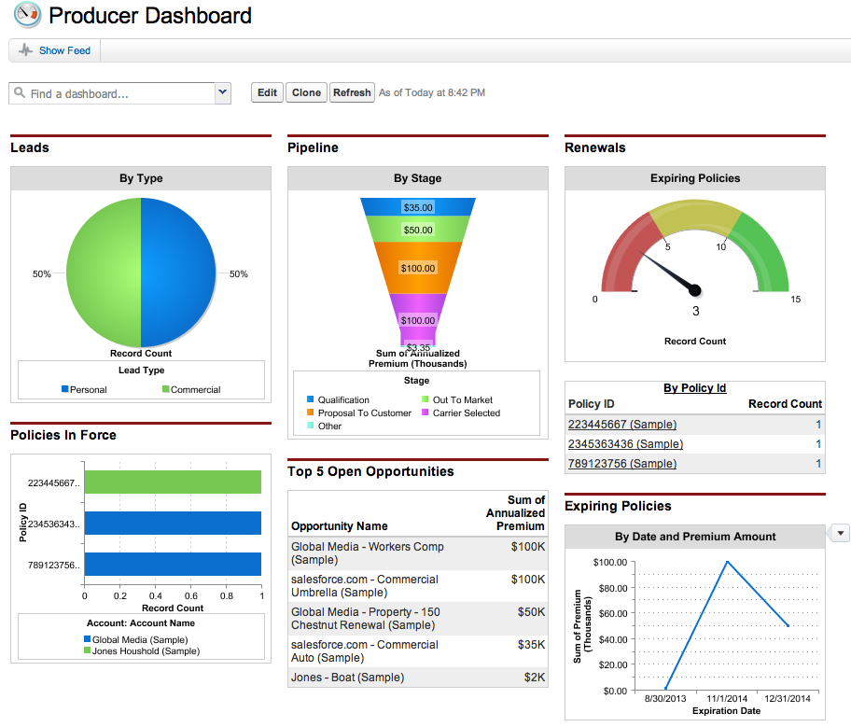

Actionable BI

Slide 22
Technical Solution
Recommended Tech Stacks
Deployment Strategy

Slide 23

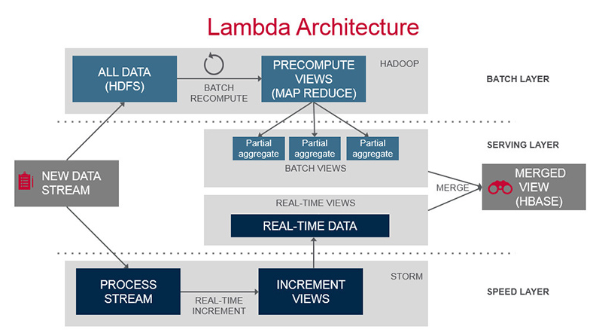





Recommended Tech Stack
Notes:
Speed Layer - Gather data
Serving Layer - Consume Data
Batch Layer - Process Data

Slide 24
Tech Layers Visual Diagram
Technical,Business and Analytics Components
Consumption Layer
Visualization
Monitoring
Analysis Layer
Entity Identification
Analytics Engine
Model Management
Security Layer
SSL
Trusted Keys
Certificates
Infrastructure and Platform Layer
Hadoop
Ingestion to DFS
Map Reduced
Distributed Storage Layer
HDFS
Ingestion Layer
Data Acquisition
Data Cleansing
Structured Data
Semi-structured Data
Unstructured Data
Data Sources
↳Weblogs
↳Sensor
↳CDR
↳Customer Sentiment
↳Yield
↳Weather
↳Satellite
↳Social Media
Notes:
7 layers

Slide 25
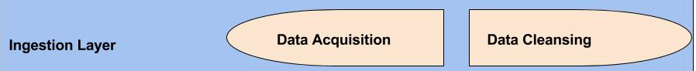
Data Cleansing Process
Step 1
Raw Data
Step 2
Technically Correct Data
Step 3
Consistent Data
Parse, Validate, Correct
Transform
Step 5
Formatted Outputs
Step 4
Statistical Results
Integrate
Compress
Notes:
Garbage IN garbage OUT, Separate relevant from irrelevant,Algorithms using java and Mapreduce,DataLadder

Slide 26

HDFS Architecture
NameNode
Metadata (Name, replicas……): /home/foo/data, 3….
Metadata Ops
Client
Block Ops
Read
Datanodes
Datanodes
Blocks
Replication
Rack 1
Write
Client
Rack 2
Notes:
Scale Out

Slide 27
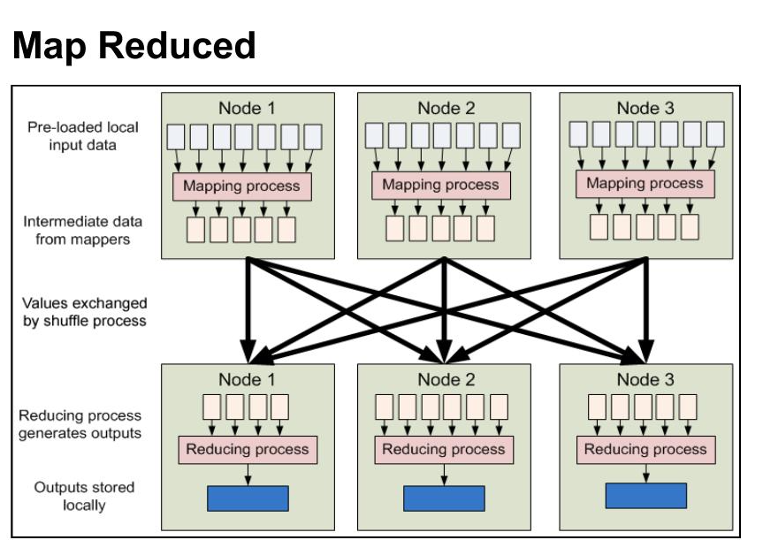
Big Data Hadoop Architecture
Data Sources
Hadoop Framework
Big Data Insight
Structured Data
HDFS
Keyword
Relevant
Content
Rich
User
Targeted
Landing
Pages
↳Yield
↳Weather
Big
Data
Landing
Zone
Map Reduced Algorithms
Semi-structured Data
↳Weblogs
↳Sensor
↳CDR
↳Customer Sentiment
Keyword Research
Content Classification/ Themes
User Segmentation
Unstructured Data
↳Satellite
↳Social Media
Notes:
Unstructured and Semistructured Data, Cluster, Batch, Java, CAP (2 of 3)

Slide 28
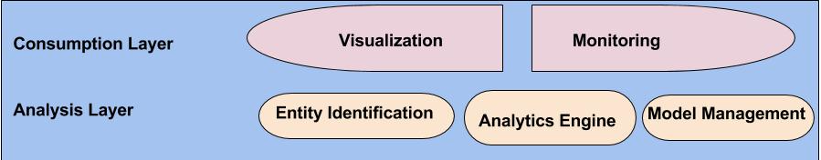
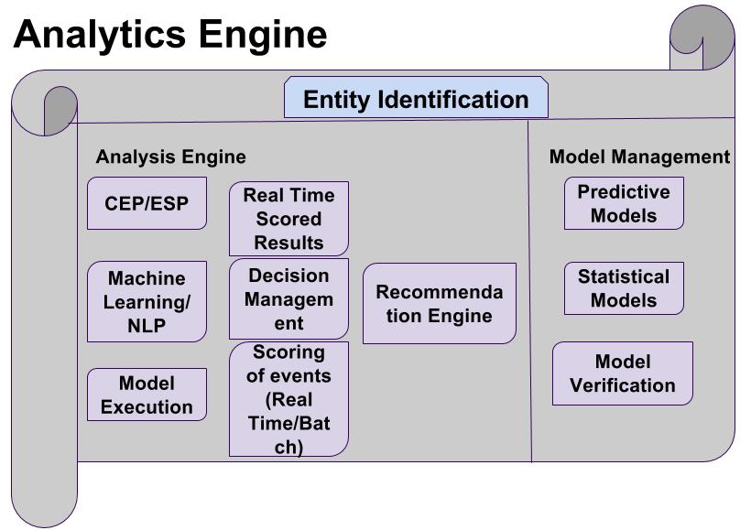
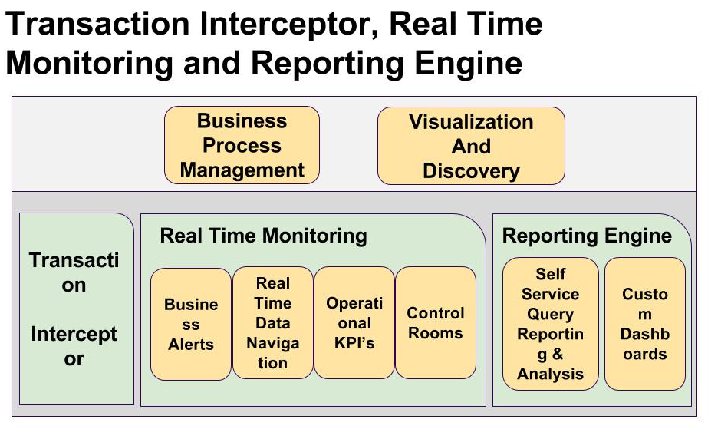
Notes:
Complex Event Processing/ Event Stream Processing, Neuro-Linguistic Programming
Simplify-modify-learn-grow

Slide 29
Deployment strategy
Frame Opportunity
Hypothesis
Data
Integration
Deployment
Modeling
1 Month Free Trial
Customer Churn
Approval
Phased Approach
Data Access
Customer Resources
Build necessary Organizational Capabilities
Integrate Analytics Into IT
Analytics Design & Output
Notes:
Start with one month free trial services of Hadoop instance on google or equivalent and data cleansing with dataladder, storm, Customer Churn and approval, A phased approach to advanced analytics can improve a company’s outcomes, Give us access to Web logs, social media data and satellite, analytics delivery and output, Integrate analytics into IT workflow, Build necessary organizational capabilities to maintain and refresh models, Provide following resources:
1 Data Engineer, 1 BI Engineer, 1 Data Scientist, 1 Network Engineer

Slide 30

Data Analysis
Solution Design Mock Up
Proposed Solution Benefits

Slide 31
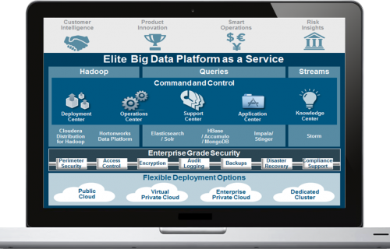
Solution Design Mockup
Summit goal - showing insights
Our visualization principles
Provoke Thought about the Subject at Hand
Make Large Datasets Coherent
Reveal Data at Several Levels of Detail
SOLUTION DESIGN MASTER

Slide 32
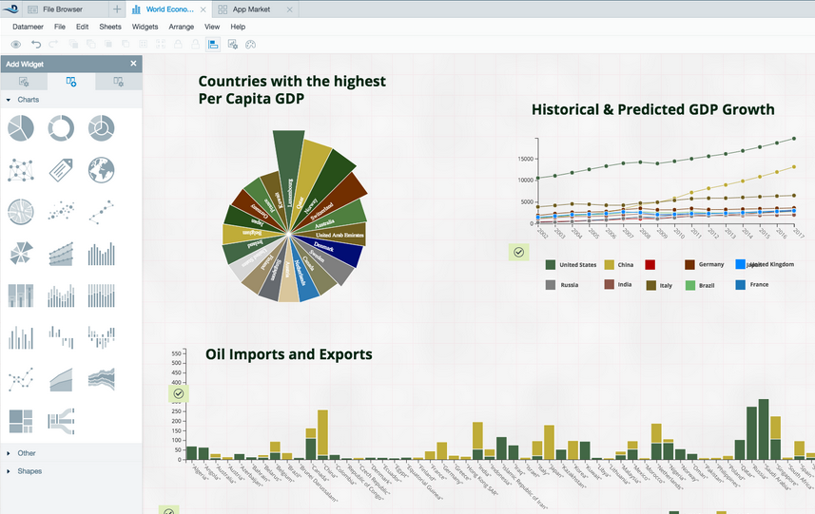
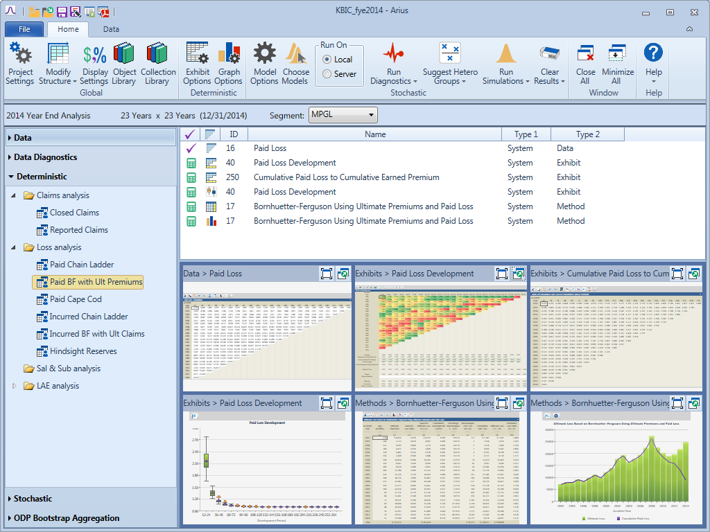
Solution Design Mockup
Dashboards for target users
Actuaries Marketing / Product managers
Catastrophic Risks
Trend by Hazard Categories
Report Status

Slide 33
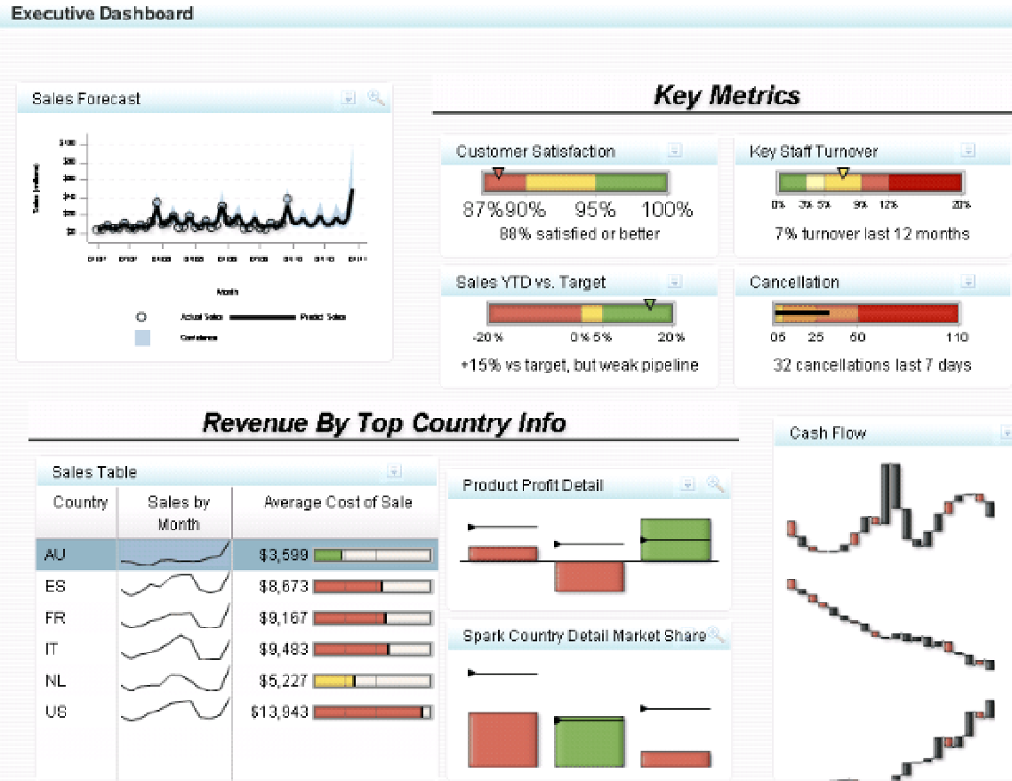
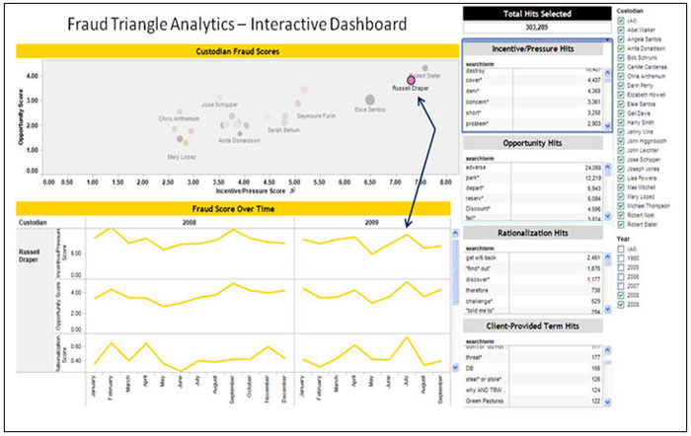
Solution Design Mockup
Dashboards for target users
Underwriter Fraud Investigator

Slide 34
Proposed Solution Benefits
Benefits For Providers
Cost effective and Customer Centric
Advanced and transparent
Efficient, Reduced risk and Fraud protected
Benefits For Clients
Wide Range and Broad Coverage
Dynamic risk control, transparent and predictable
Early warnings and fast claims
Notes:
Providers
Cost effective product offerings that are flexible and tailored to customer needs , Elongated customer retention, Improved customer service with focus on specific needs
Advanced actuarial science for more accurate pricing, Upgraded interconnectivity with data transparency
More efficient claims and indemnity processing, Reduced risk with open access modeling, Better fraud protection
Clients
Support wider range of farming businesses, Broader coverages on property and liability
Dynamic risk control from global impact, Improved interconnectivity with data transparency and prediction
Early warnings with global models, Fast claims and indemnity
Great Comfort coverage added with little or no cost

Slide 35
Thank You

